Slide 1
Hot Pursuit
Python with Robots Mission 7
Lesson 3 Objectives 8-11

Slide 2

Pre-Mission Warm-Up
In your Mission 7 Lesson 3 log, answer the pre-mission warm-up questions:
What code must be included before the motors of CodeBot will run?
What code will turn the ‘bot to the left?

Slide 3
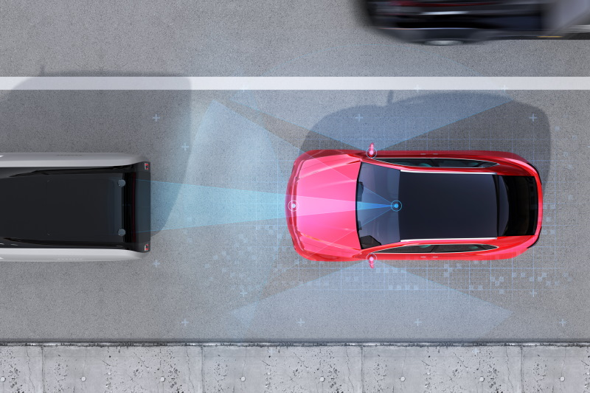
Mission 7: Hot Pursuit
In this project you will:
Go in-depth with the proximity sensors.
Write code to detect, pursue and avoid objects.
These sensors add an awesome new dimension to CodeBot’s capabilities!

Slide 4
Mission 7: Hot Pursuit
Project Goals:
Use the basic proximity sensors detect() function to make a presence detector.
Experiment with light and dark ground-surfaces to find the best emitter power and detection threshold levels for each environment.
Use the range() function to make an interactive display of object reflectivity.

Slide 5

Mission 7: Hot Pursuit
Project Goals:
Write calibration functions so CodeBot can adapt to its environment.
Bring in the motors for a FaceOff challenge.
Code a “Curious Puppy Bot” that will chase a ball around.

Slide 6
Mission 7: Hot Pursuit
For this lesson, we will work on the last two goals:
Bring in the motors for a FaceOff challenge.
Code a “Curious Puppy Bot” that will chase a ball around.

Slide 7

Objective #8: Face Off!
Are you ready to get moving?
I thought so!
Get your motors running!
Your program already uses CodeBot’s proximity sensors to detect an object.
The next goal is to rotate and face an object moving in front of it.

Slide 8

Objective #8: Face Off!
You just need to add a small amount of code to the end of your main while loop to make it happen.
Your while True loop uses this code:

Slide 9
Objective #8: Face Off!
The cal_thres() function assigns a tuple to sensed.
After assigning a tuple to sensed, you were able to access only the LEFT or RIGHT value with sensed[LEFT] and sensed[RIGHT]
You can do the same thing with p.

Slide 10
Objective #8: Face Off!
With the code
the value of p is a tuple of 2 Bools.
The left sensor detection is p[LEFT] and the right sensor detection is p[RIGHT]
Their value is either True or False.

Slide 11
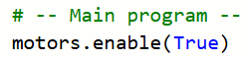
Objective #8: Face-Off Algorithm
Use an if statement with p[LEFT] and p[RIGHT] to control the direction of the motors.
Enable the motors
You can do this before the while True loop.

Slide 12
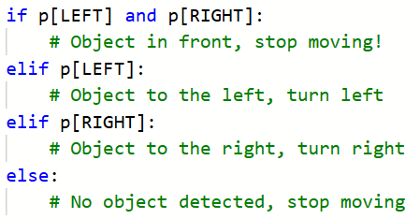
Objective #8: Face-Off Algorithm
After reading the proximity sensors, use an if statement with four branches to control the motors.
  Stop the motors if both sensors detect an object.
  Turn a little left if only the LEFT sensor detects an object.
  Turn a little right if only the RIGHT sensor detects an object.
  Otherwise, stop both motors.

Slide 13
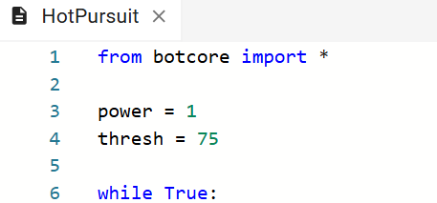
Objective #8 Activity
Let’s put the algorithm into the program.
DO THIS:
Open your program – HotPursuit

Slide 14
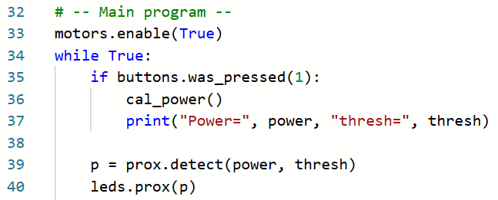
Objective #8 Activity
DO THIS:
Enable the motors by adding code just above the while True loop.

Slide 15
Objective #8 Activity
DO THIS:
At the end of the while True loop, add the if statement to control the motors.
You can turn left and turn right any way you want.
NOTE: Keep the rotation speed low while testing.
Sample code is provided on the next slide, but you can customize the turns with your own code.

Slide 16
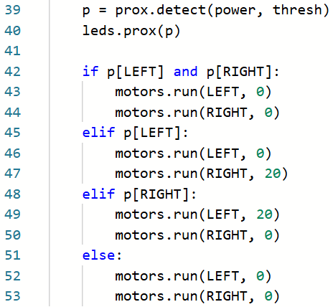
Objective #8 Activity code

Slide 17
Objective #8 Activity
DO THIS:
Place CodeBot on the floor or a table.
Start with no object in front of the ‘bot.
Run the code.
Calibrate the ‘bot by pressing BTN-1.
Move an object in front of the ‘bot. It should turn only when one sensor sees the object and stop when the object is in front or no object is detected.
Try different speeds for the rotation.
NOTE: The program does not have a safety feature (yet) and will start when the program runs.

Slide 18
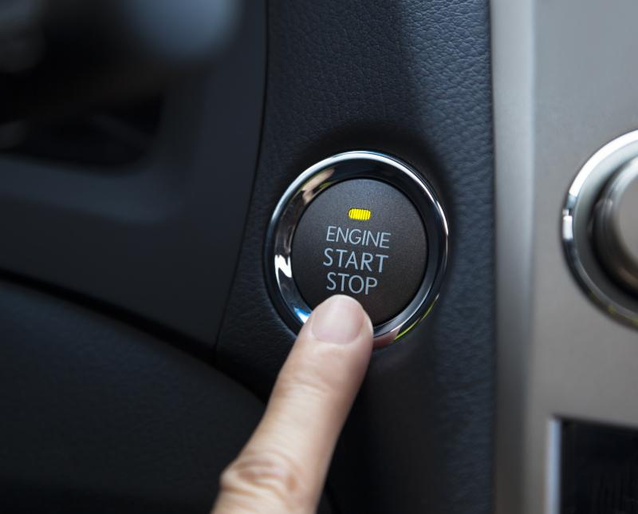
Objective #9: Face Off Harder!
While you are testing code like this it’s nice to be able to toggle the motors on and off.
This can be a safety feature!
Toggle means to flip back and forth between two values, like True/False or on/off.
The logical operator “not” can help us toggle a Boolean value.

Slide 19

Objective #9: Face Off Harder!
Concept: Toggle a variable
Start with a Boolean variable and assign it a value.
Then flip the value with the “not” operator.
In this example, the variable is first False, and then it flips, or toggles, to True:

Slide 20

Objective #9: Face Off Harder!
Concept: Toggle a variable
If the variable is toggled again, it returns to its original value (False)
DO THIS:
Try the sample toggle problems in your mission log.

Slide 21

Objective #9: Safety Feature Algorithm
Use a toggle Boolean variable to turn on/off the motors.
Define a toggle Boolean variable.
The motors will start disabled, so you can delete the motors.enable(True) command in the main program.

Slide 22
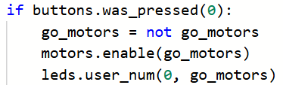
Objective #9: Safety Feature Algorithm
Use a button press to turn on/off the motors by:
  Toggling the variable.
  Using the variable to turn on/off the motors.
  Indicate the status with a user LED.

Slide 23
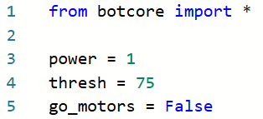
Objective #9 Activity
DO THIS:
Modify your program to include the safety feature using a toggle Boolean variable.
Define a toggle Boolean variable.

Slide 24

Objective #9 Activity
DO THIS:
Delete the motors.enable(True) line of code in the main program.

Slide 25
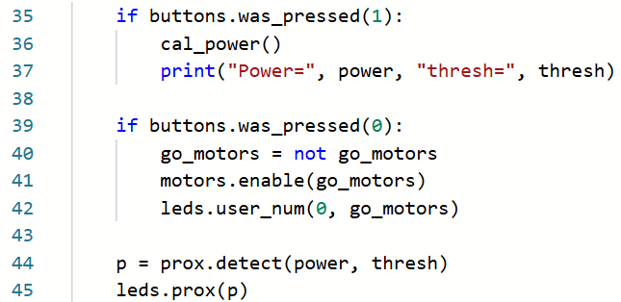
Objective #9 Activity
DO THIS:
Add an if statement for a button press to toggle the variable, control the motors, and show the status with a user LED.

Slide 26
Objective #9 Activity
DO THIS:
Place CodeBot on the floor or a table.
Start with no object in front of the ‘bot.
Run the program.
Calibrate the ‘bot by pressing BTN-1.
Move an object in front of the ‘bot. The proximity sensors should detect the object, but the motors do not run.

Slide 27
Objective #9 Activity
DO THIS:
Enable the motors by pressing BTN-0.
Place an object in front of a sensor. The ‘bot should turn.
Test your code by toggling the motors on and off and calibrating the ‘bot.
Try different rotations and speeds.

Slide 28

Objective #10: Chase Mode
Your ‘bot only needs a tiny nudge now to not just track an object, but to chase after it!
A simple algorithm:
If both LEFT and RIGHT sensors see an object, move forward.
Keep the rest of the tracking algorithm.

Slide 29
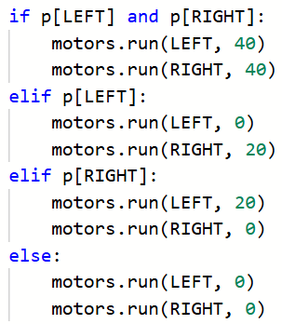
Objective #10 Activity
DO THIS:
Modify the if statement in the main program to move the ‘bot when both sensors detect an object.
You can use any speed you want. My suggestion is to use double the turning speed.

Slide 30
Objective #10 Activity
DO THIS:
Place CodeBot on the ground.
Run the program.
Calibrate the ‘bot and enable the motors.
Test your code with a variety of objects.
  What sizes, shapes and colors work best?
  Record your findings in the mission log.

Slide 31
Objective #10 Activity
Other things you can try:
Adjust the speed for moving forward and turning.
  What speed seems to work the best?
Turn an empty paper cup on its side. Place it in front of the ‘bot.
  Does CodeBot follow it around?

Slide 32

Objective #11: More House Cleaning
Your code is getting pretty long.
Take some time to organize your code by defining more functions.
A function is a form of abstraction.

Slide 33
Concept: Abstraction
A function is a form of abstraction.
Abstraction: the process of taking away or removing characteristics from something in order to reduce it to a set of essential characteristics
What this means is that you can take a task and give it a name (like a function). Then you don’t have to worry about the details of the task, but on the task itself and when to use it.

Slide 34

Concept: Abstraction
Source: Code.org CodeBreak 11.0 with Hadi Pavarti & Susan Wojcicki
Notes:
https://www.youtube.com/watch?v=YjTynTwrcxA&t=2s

Slide 35

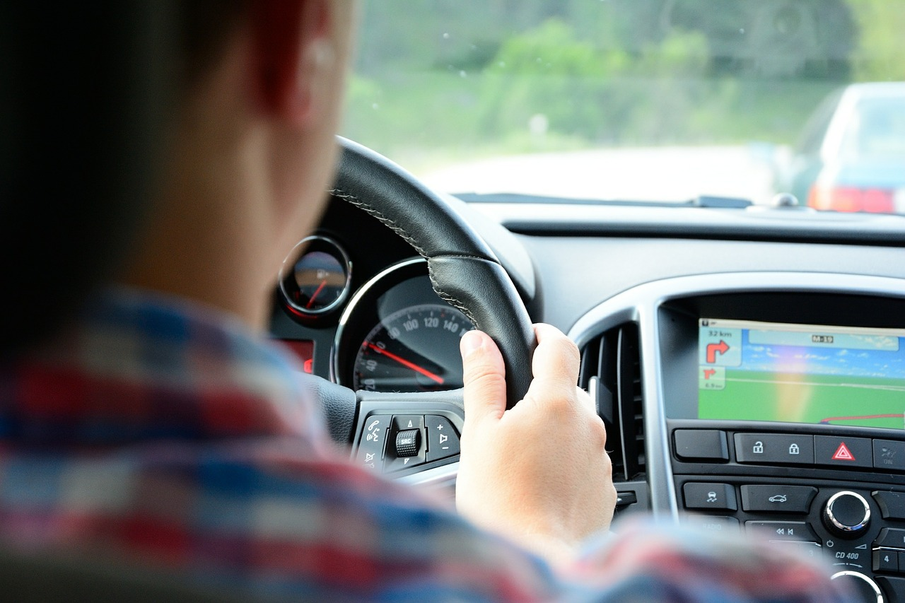
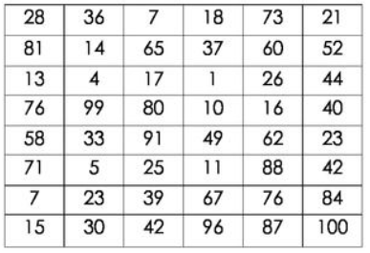
Examples of abstraction
Wash the dishes
You don’t have to be told every step for this task, which is the underlying details. The task has a name and you know what to do.
Turn left when driving
You don’t need to know how the car is turned when you use the steering wheel. The details are hidden but you can still drive the car
Select the highest number
There are many ways to find the highest number in a list. You don’t need to see the details of how it is done, just that when you complete the task the highest number will be found.

Slide 36
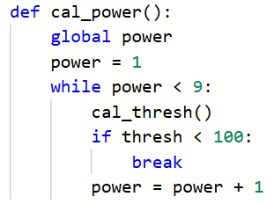
A function is abstraction
A section or block of code accomplishes a specific task
Give the block of code a name
  This “hides” the details
  Focus on when to use the block of code
Instead of writing all the code when the task is needed, a programmer calls the function by name
The function can be called multiple times in a program

Slide 37
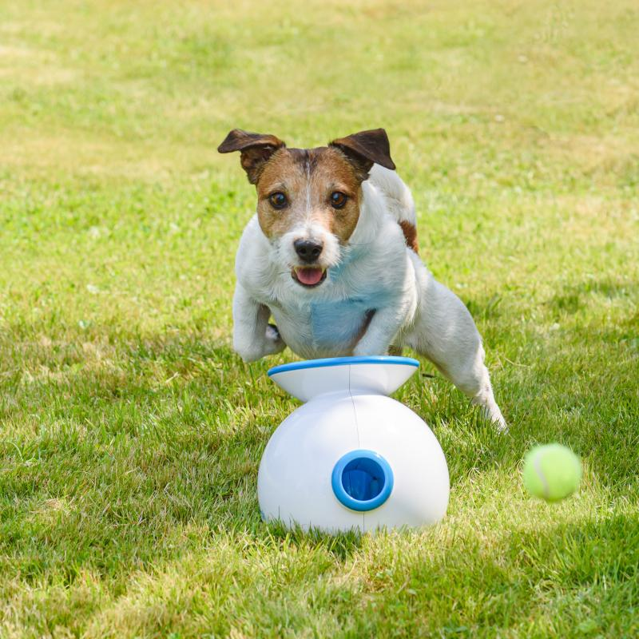
Objective #11: More House Cleaning
Let’s add abstraction to the program by defining two more functions.
A function for driving the ‘bot.
A function for toggling the Boolean variable and turning on/off the motors.

Slide 38
Objective #11 Activity
DO THIS:
Define a function for drive().
Include two parameters: left_speed and right_speed.
Use the parameters to control the left and right motors.
Remember: Functions are defined in one section near the top of the program.

Slide 39
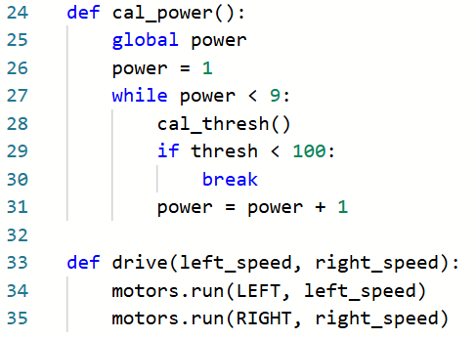
Objective #11 Activity Code

Slide 40
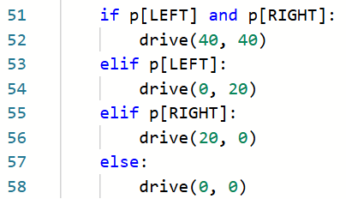
Objective #11 Activity Code
DO THIS:
Call the drive() function in the main program’s if statement.

Slide 41
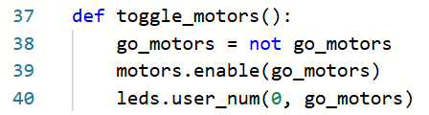
Objective #11 Activity
DO THIS:
Define a function to toggle the Boolean variable.
Cut the code from the BTN-0 press and paste it in the function.

Slide 42
Objective #11 Activity
DO THIS:
Do you notice something about this function and its variable?
go_motors is a global variable!
Add the global statement at the beginning of the function.

Slide 43
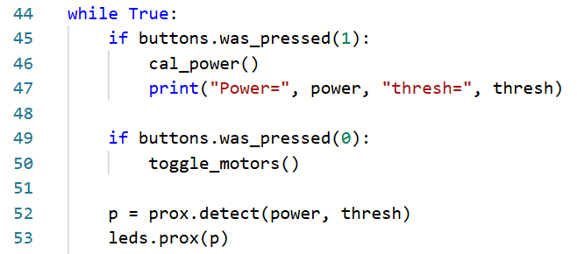
Objective #11 Activity
DO THIS:
Call the toggle_motors() function in the main program inside the BTN-0 press.

Slide 44

Extension #1
(From Lesson 2) If the ‘bot is pointed up, with no surface, the code will throw a runtime error in the cal_power() function. Fix the error. You can use in if statement, similar to the “bug” fix for the threshold.

Slide 45
Extension #2
This program uses button presses. You learned from Mission 4 that button presses can have a bounce. Review how to debounce a button press and add the code to the program.

Slide 46
Extension #3
Add a variable for the speed. This can help with testing, because you can change the speed in one place near the top instead of scrolling to the main program.
You can use the speed variable as the argument when calling drive().
Think of a relationship between the forward speed and turn speed.
Use the math in function call. An example is given where the turn speed is half the forward speed.

Slide 47
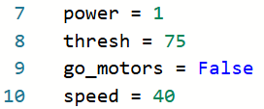
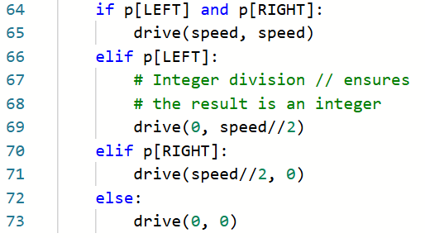
Extension #3

Slide 48
Post-Mission Reflection
Complete the post-mission reflection in your Mission 7 Lesson 3 Log:
List three new things you learned during this lesson.
Do you think using functions and abstraction improves your code? Why or why not?

